Slide 1
Long-Term Corrosivity at NASA Kennedy Space Center as a Function of Distance and Time from the Atlantic Ocean
Dr. Eliza L. Montgomery, Dr. Michelle S. Pierre, and Mya M. McMullen
2023 DoD Corrosion Prevention Technology and Innovation Symposium – August 2023
NOT EXPORT CONTROLLED

Slide 2
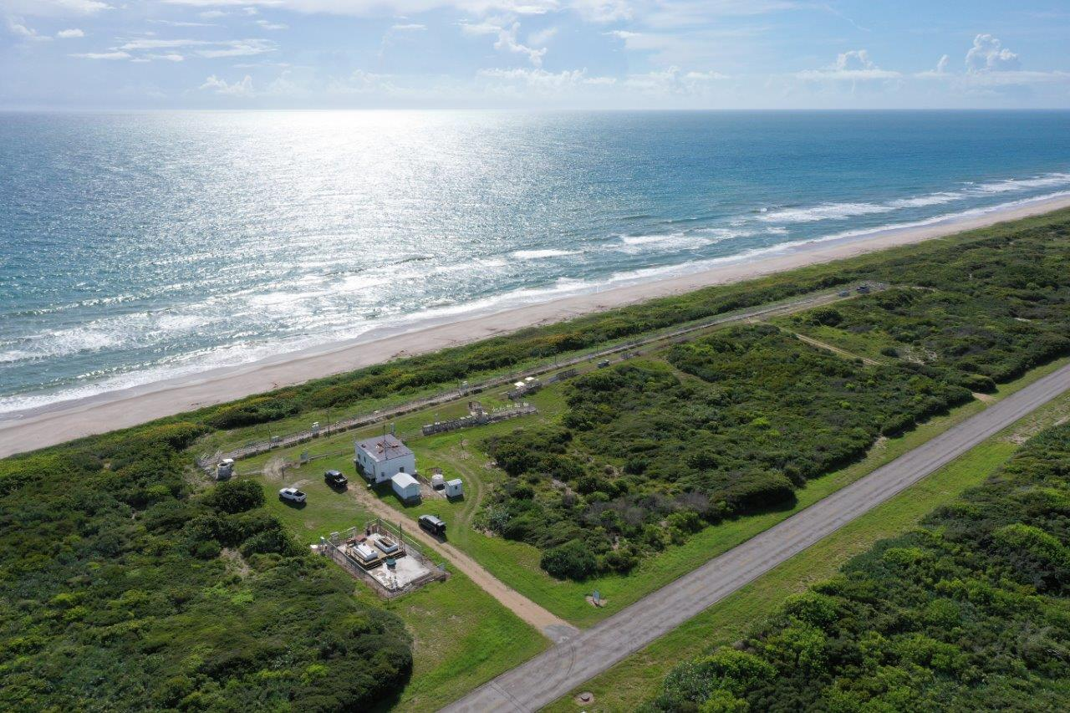
PURPOSE AND GOALS
Purpose
Long-term data to record both seasonal and notional bounding values for corrosivity at multiple sites at NASA Kennedy Space Center was needed to make better materials choices for NASA-based ground and spaceflight programs
Sites chosen from 45 meters (150 feet) to 8 kilometers (5 miles) from the Atlantic Ocean
Corrosion variables measured June 2017 through April 2023 (ongoing to present), except the Beachside site, which includes data from November 2010
Goals
Measure corrosion rate and chloride concentration as a function of time and distance from the Atlantic Ocean
Compare the corrosivity at launchpad and site-specific areas to the more accelerated conditions at the KSC Beachside Atmospheric Corrosion Test Site for coating and materials performance prediction
Location of corrosion rate panels and wet candles
NASA KSC Beachside Atmospheric test Site

Slide 3
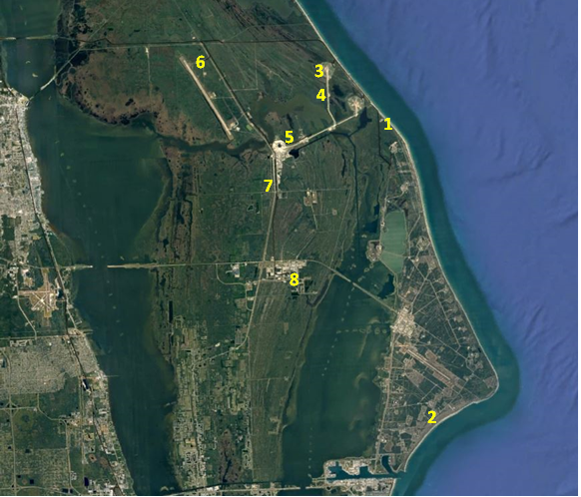
TEST SITE LOCATIONS
Test Sites Monitored for Corrosion Rate and Chloride Concentration by NASA KSC.
Site Designation | Location/Name | Distance from Atlantic Ocean | Conditions Tested
1 - KSC Beach | Beachside Atmospheric Corrosion Test Site | 45 meters (150 feet) | Marine, fully exposed and partially covered
2 - ARL CCSFS | Army Research Lab (ARL) site at Cape Canaveral Space Force Station (CCSFS) | 183 meters (602 feet) | Marine, fully exposed
3 - LC-39B | Launch Complex 39B, (LC-39B) | 1207 meters (0.75 miles) | Marine, fully exposed and partially covered
4 – Crawlerway | Crawlerway at LC-39B | 2012 meters (1.25 miles) | Coastal, fully exposed
5 - VAB | Vehicle Assembly Building (VAB) | 5632 meters (3.5 miles) | Uncontrolled interior, intermittently exposed to environment
6 - Doppler | Tropospheric Doppler Radar Wind Profiler (TDRWP) | 6920 meters (4.3 miles) | Coastal, fully exposed and partially covered
7 - Schwartz | Schwartz Rd, location not impeded by vegetation | 8046 meters (5.0 miles) | Coastal, fully exposed
8 - LETF | Launch Equipment Test Facility (LETF) | 8046 meters (5.0 miles) | Coastal, fully exposed and partially covered, industrial
Test Sites Monitored for Corrosion Rate at NASA KSC

Slide 4
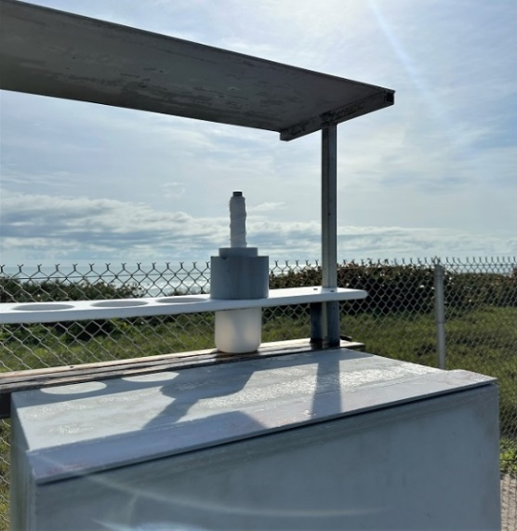
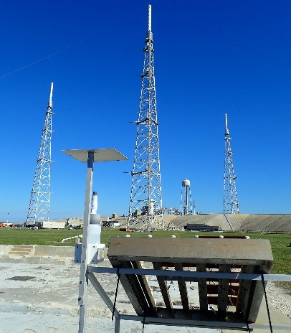
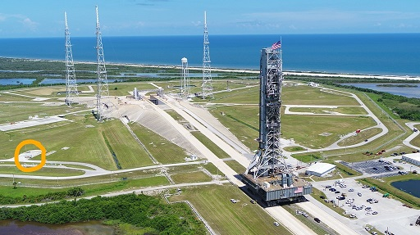
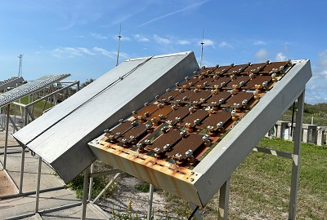
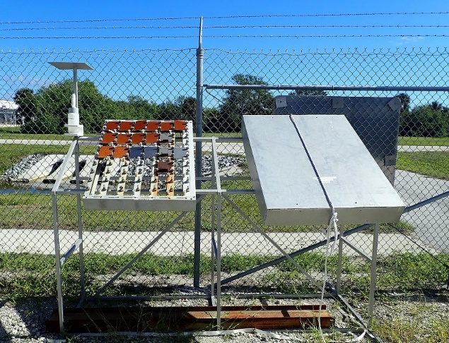
DATA COLLECTION Methods
Wet Candle Exposure Samples
Chloride deposition monitored continuously using the wet candle method, ISO 9225
One or two candles, depending on the test site, exposed for a one-month period
Chloride concentration measured using a chloride ion probe via method EPA 9212
Corrosion Rate Exposure Samples
Corrosion rates measured using carbon steel panels as site calibration coupons
1010 steel (UNS 10100), 4 x 6 x 0.125 in, placed 30-degrees towards the Atlantic Ocean
Panels placed monthly or quarterly depending on location and exposed for one year
Corrosion products removed using aluminum oxide blast media
Data normalized as corrosion rates per standard ASTM G1
Atlantic Ocean
Wet Candle
Example of wet candles exposed to KSC atmospheric conditions and used to measure chloride concentration per month
Overview (right) and close-up (left) of corrosion rate panels and wet candle set-ups at NASA KSC LC-39B site
Example of corrosion rate panels and wet candle set-ups at NASA KSC test sites, including the Beachside Atmospheric Corrosion Test Site (left) and LETF (right)

Slide 5
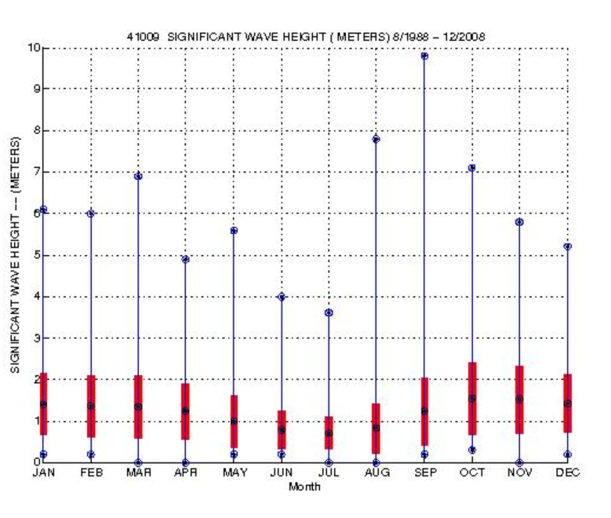
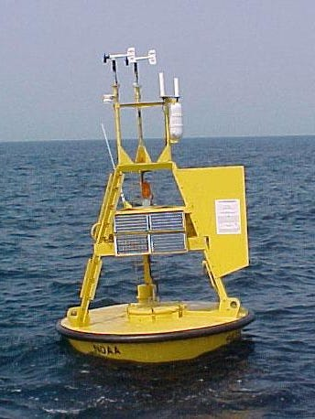
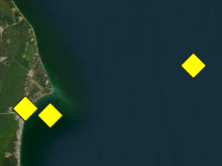
DATA COLLECTION Methods
Wave Height Measurements
Wave height measurements collected from weather buoy #41009, off the coast of Cape Canaveral
Funded by NASA and operated by the NOAA National Data Buoy Center
Wave height relates to the amount of salt aerosols in the air that can travel to test samples
LC-39B
Beach site
Buoy 41009
General location of Weather Buoy Station 41009 (left) and close-up image (right).
Station 41009 – Climatic Summary Plot for significant wave height mean and standard deviation.

Slide 6
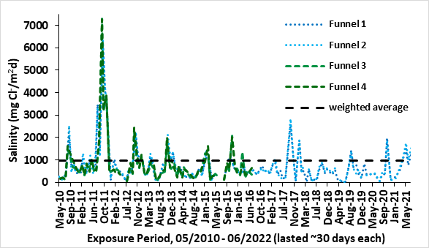
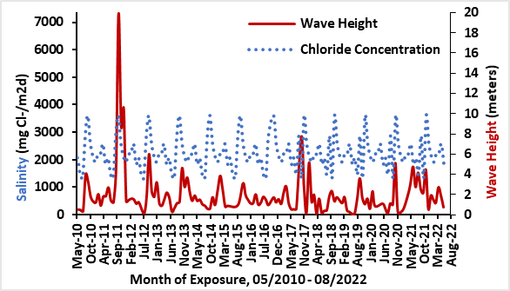
Results: KSC beachside Atmospheric corrosion test site - salinity and wave height
Chloride Concentration
Exposure period May 2010 through June 2022, chloride deposition considered high per ISO 92239 standard
Average range of deposition rate is recorded between 300 and 1500mg/m2d, with a total range of 50-7300mg/m2d, and a weighted mean average yearly value of 982mg/m2d
Wave Height
Increased wave height is generally related to an increase in chlorides in the air
Summary
Repeat pattern: chlorides recorded to be much higher in the December-March timeframe correlating to the lower average ambient temperatures and higher wave heights in the winter months that increase the daily time of wetness and dew point
Chloride concentration as a function of exposure period, obtained using wet candles exposed at the KSC Beachside Atmospheric Corrosion Test Site
Wave height recorded from NOAA Buoy Center Station 41009 compared to chloride concentration recorded at the KSC Beachside Atmospheric Corrosion Test Site

Slide 7
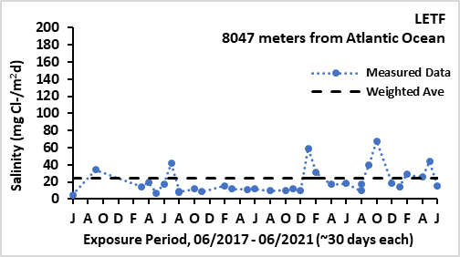
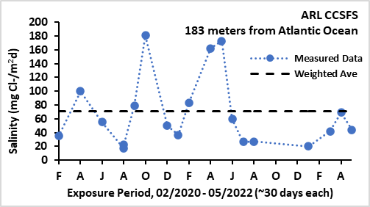
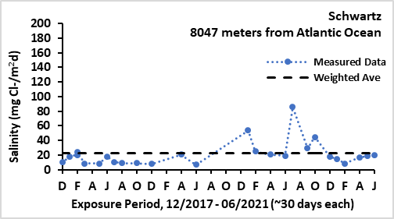
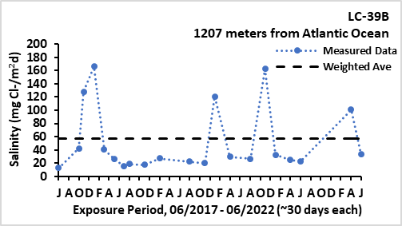
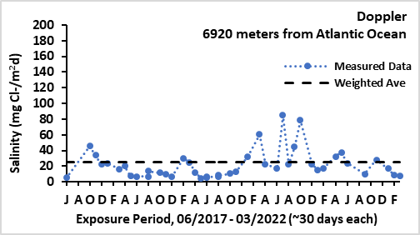
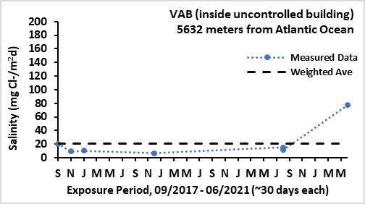
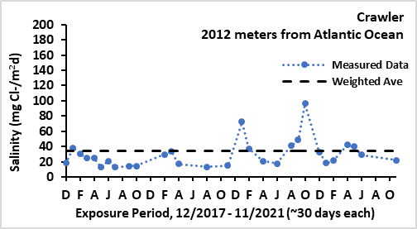
Results: Remote atmospheric test sites - chlorides
Test sites closer to Atlantic Ocean produced higher chloride concentration values in comparison to sites located farther from the ocean
Weighted average included on each graph to act as a representative value per site
Similar seasonality trends seen at the KSC Beach Site were also seen at the remote sites
Chloride concentration as a function of exposure period, obtained using wet candles exposed at KSC Remote Atmospheric Test Sites.

Slide 8
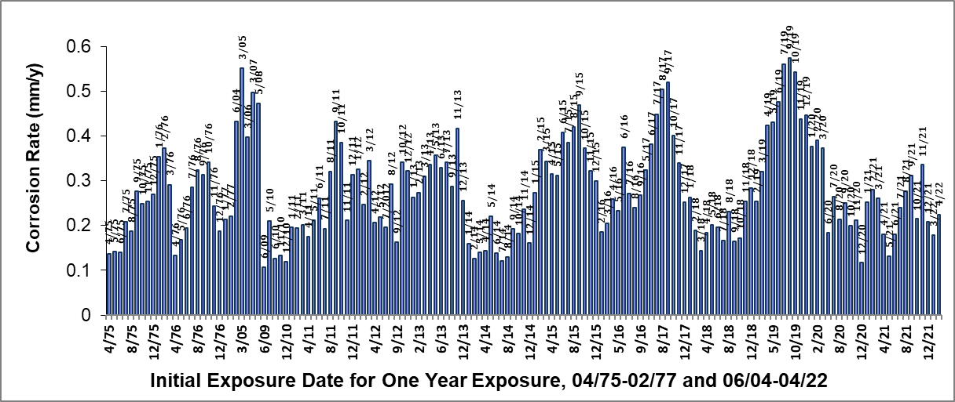
Results: KSC beachside Atmospheric test site - corrosion rates
Corrosion Rate
Corrosion rates measured continuously April 1975 - February 1977, intermittently June 2004 – June 2009, and then continuously November 2010 - April 2022
Corrosion rate varies from 0.127 mm/y to 0.51 mm/y (5.0 to 20.0 mpy), with a weighted average of 0.28 mm/y (11.0 mpy)
Summary
Seasonal changes that influence corrosion rate are evident
Panels initially exposed from April through June have lower corrosion rates when compared to those exposed during the rest of the year, (with exceptions for years during when major storms occurred). Temperatures are higher, causing moisture to evaporate faster (less TOW).
Corrosion rate as a function of exposure period at the KSC Beachside Atmospheric Corrosion Test Site.

Slide 9
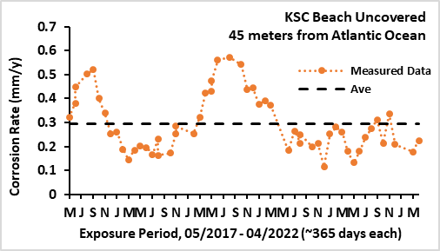
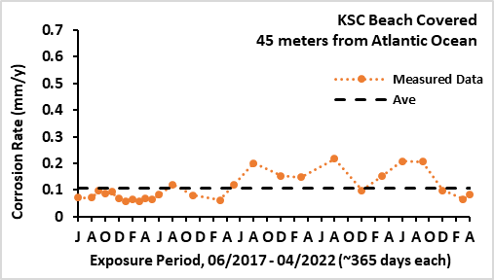
Results: KSC beachside Atmospheric test site - corrosion rates
Covered and Uncovered
Comparison of corrosion rate values between covered and uncovered test panels
Differences due to factors imposed by direct ocean proximity to environmental conditions such as:
  Marine aerosols
  Precipitation
  Wind
Samples with covering do not get direct access to the environment on the top and sides
Corrosion rate as a function of exposure time at the KSC Beachside Atmospheric Corrosion Test Site for uncovered (left) and covered (right) test panels.

Slide 10
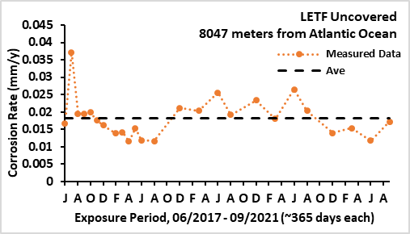
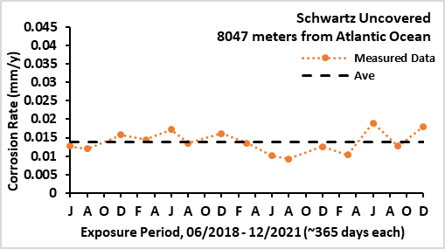
Results: Remote atmospheric test sites - corrosion rates
Test sites closer to Atlantic Ocean resulted in higher corrosion rate values in comparison to sites located farther from the ocean
Weighted average included on each graph to act as a representative value per site
Similar seasonality trends seen at the KSC Beach Site were also seen at the remote sites
Corrosion rates for uncovered test panels as a function of exposure time at the KSC Remote Test Sites.

Slide 11
Results: covered/uncovered Remote atmospheric test sites - corrosion rates
Corrosion rates at the remote uncovered and covered sites are considerably much lower than at the beachside site
Values statistically insignificant between the two exposure conditions, uncovered and covered
Data for uncovered sites are more variable
Corrosion rates for uncovered (left) and covered (right) test panels as a function of exposure time at the KSC Remote Test Sites.

Slide 12
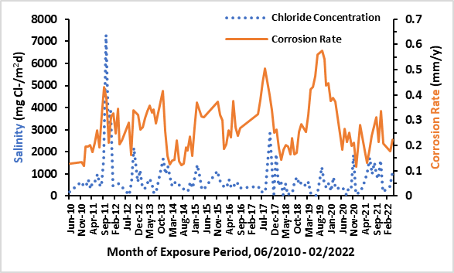
Conclusion: KSC Beachside Atmospheric Corrosion Test site
Variability in data due to seasonal changes was observed consistent for both corrosion rate and chloride concentration
Correlation demonstrates direct relationship between corrosion rate and chloride concentration, intuitive
Comparison of chloride concentration and corrosion rate values at the KSC Beachside Atmospheric Corrosion Test Site.

Slide 13
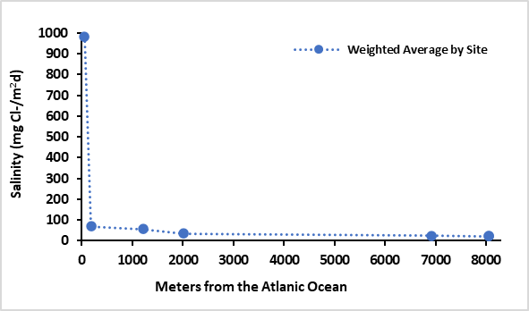
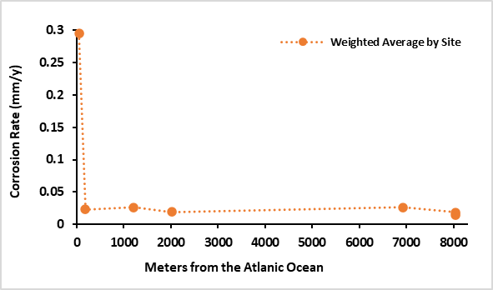
Conclusion: Chloride Concentration and Corrosion Rate as function of distance from Atlantic Ocean using site representative values
Weighted averages at each site used to create representative values for chloride concentration and corrosion rate measurements based on the distance from the Atlantic Ocean
Distinct decline in chlorides and corrosion rate values between the first two sites (45 and 183 meters)
Remaining sites located more inland have similar and marginally low values from 183 to 8047 meters
Chloride concentration as a function of distance from the Atlantic Ocean for all NASA KSC site locations.
Corrosion rate as a function of distance from the Atlantic Ocean for the uncovered site locations.

Slide 14
Conclusion: Chloride Concentration and Corrosion Rate as function of distance from Atlantic Ocean using site representative values
Numerical chloride concentration and corrosion rate values for reference
Tables for uncovered and covered corrosion rate samples, for comparison
Corrosion rate (uncovered samples) and chloride concentration as a function of distance from the Atlantic Ocean.
Site | Distance from the Atlantic Ocean, meters (feet or miles) | Corrosion Rate for Uncovered Samples mm/y (mpy) | Chloride Concentration (mg Cl-/m²d)
KSC Beach | 45 (150 feet) | 0.295 (11.6) | 982
ARL CCSFS | 183 (602 feet) | 0.023 (0.91) | 70.6
LC-39B | 1207 (0.75 miles) | 0.026 (1.02) | 57.1
Crawler | 2012 (1.25 miles) | 0.019 (0.76) | 34.5
Doppler | 6920 (4.3 miles) | 0.026 (1.04) | 24.9
Schwartz | 8047 (5 miles) | 0.014 (0.54) | 23.1
LETF | 8047 (5 miles) | 0.018 (0.72) | 23.9
Corrosion rate (covered samples) and chloride concentration as a function of distance from the Atlantic Ocean.
Site | Distance from the Atlantic Ocean, meters (feet or miles) | Corrosion Rate for Covered Samples, mm/y (mpy) | Chloride Concentration (mg Cl-/m²d)
KSC Beach | 45 (150 feet) | 0.295 (11.6) | 982
LC-39B | 1207 (0.75 miles) | 0.026 (1.02) | 57.1
VAB | 5632 meters (3.5 miles) | 0.005 (0.02) | 20.7
Doppler | 6920 (4.3 miles) | 0.026 (1.04) | 24.9
LETF | 8047 (5 miles) | 0.018 (0.72) | 23.9

Slide 15
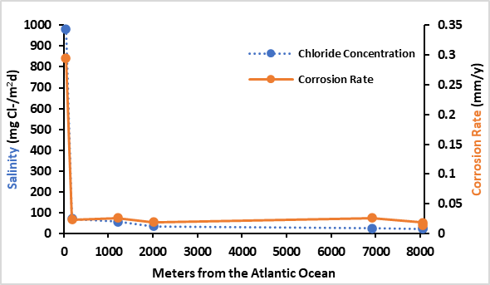
Conclusion: Relevance of results
Corrosion rate and chloride concentration as a function of distance from the Atlantic Ocean.
Corrosion rate and salinity values demonstrate similar decreases as a function of distance to the Atlantic Ocean
Values are significantly higher at the Beachside site compared to the remote sites
Remote sites have low values that are similar regardless of distance from the Atlantic Ocean
Differences for corrosion rates and chloride concentration may become more relevant depending on operations occurring at each location
This presentation provides the numerical values for corrosion rate and salinity with their corresponding seasonal ranges as a function of distance from the Atlantic Ocean to be used as a standard data set for future lifetime predictions and qualifications
Site | Distance from the Atlantic Ocean, meters (feet or miles) | Corrosion Rate mm/y (mpy) | Chloride Concentration (mg Cl-/m²d)
KSC Beach | 45 (150 feet) | 0.295 (11.6) | 982
ARL CCSFS | 183 (602 feet) | 0.023 (0.91) | 70.6
LC-39B | 1207 (0.75 miles) | 0.026 (1.02) | 57.1
Crawler | 2012 (1.25 miles) | 0.019 (0.76) | 34.5
Doppler | 6920 (4.3 miles) | 0.026 (1.04) | 24.9
Schwartz | 8047 (5 miles) | 0.014 (0.54) | 23.1
LETF | 8047 (5 miles) | 0.018 (0.72) | 23.9
Combined chloride concentration and corrosion rate values as a function of distance from the Atlantic Ocean.

